Slide 1
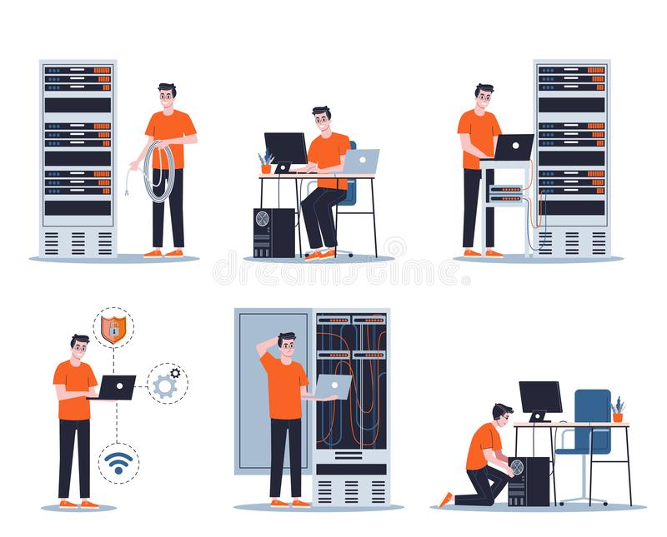
Systems and Networks Administration
GIC 2022
Managing and Configuring Services

Slide 2
Network Services (Recap)
We’ve talked about lots of network services:
Domain Name System maps names (website url) to IP addresses.
DHCP assigns IP addresses to clients automatically
NTP provides time synchronization
So, what make these services running?

Slide 3
Managing Services
It’s important to understand how the programs that provide those services operate.
The program run as background process called Daemon or service.
The program doesn’t need to interact with user through GUI or command line interface.
Each service has one or more configuration files that are used to determine how the service should operate.
Some services may rely on the system infrastructure and their configuration files need to be edited.
As a sysadmin or IT support specialist, we need to know how to start, stop and inspect the current status of these services.
Most services are usually configured to start when the machine boots.
They can also be configured to restart when they crash.

Slide 4
Managing Services in Linux
How to start, stop , look at the status and restart the services in Linux?
systemctl: Linux command-line utility used to control system or services.
To start: systemctl start service-name
To stop: systemctl stop service-name
To restart: systemctl restart service-name
To start every time machine boot: systemctl enable service-name
We can also use service command to do the same thing:
service service-name start

Slide 5
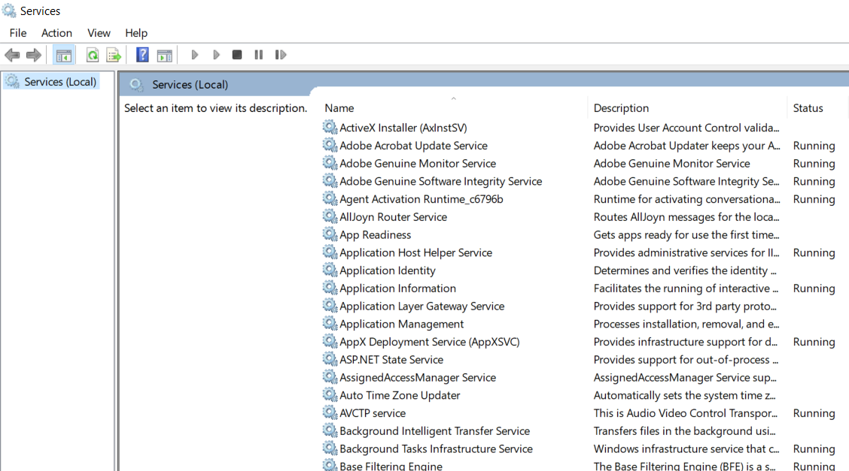
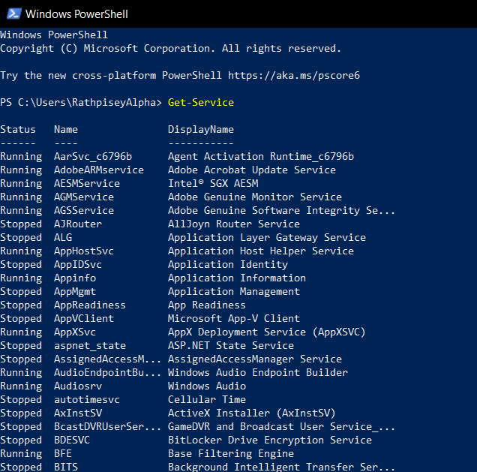
Managing Services in Windows
In Windows, we can GUI or Powershell to interact with the services.

Slide 6
Configuring Services
As a sysadmin, we also have to know how to configure services to meet the need of organization.
For example:
If you're running a DNS server, you'll need to configure the DNS zones that you want to serve.
If you're running a Web server, you'll need to configure the different sites and Web applications that you'd like to have enabled.

Slide 7
Configuring Services
As a sysadmin, we also have to know how to configure services to meet the need of organization.
For example:
If you're running a DNS server, you'll need to configure the DNS zones that you want to serve.
If you're running a Web server, you'll need to configure the different sites and Web applications that you'd like to have enabled.

Slide 8
Configuring Services
On Windows, most of the configuration is stored in the registry. This can be modified using graphical wizards or using the set service command.
On Linux, the configuration files for the installed services are located in the /etc directory. And while some software may ship graphical configuration editors, you typically have to edit the configuration files with a text editor.

